Slide 1
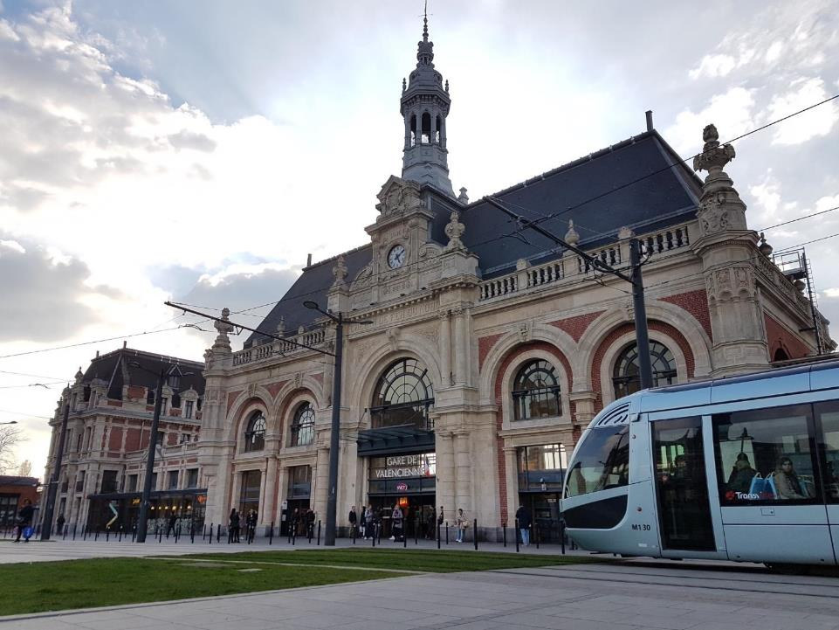


Experts in Railway Certification

Slide 2
RSSR 2017
Safety Certification:
considering processes around the world
Aryldo G Russo Jr.
CERTIFER’s Director

Slide 3

Our strengths
Provision of rail certification services is our core business
Top 3 worldwide
Leader in France, Belgium, Luxembourg & Algeria
20 years of experience
National and international recognitions
More than 400 assessors from whole railway sectors

Slide 4
The CERTIFER GROUP worldwide

Slide 5
Global Services
Energy
Operation
&
Maintenance
Signalling & Telecom
Global
System
Rolling Stock
Infrastructure

Slide 6
ISA Mission
The CERTIFER GROUP performs safety assessment on global transit system or any sub-system and products
Transit System
We use an assessment methodology based on the EN 50126, 50128 and 50129 standards
EN 50159 1&2 - Communication
EN 50126 -RAMS
Signaling
Sub-System
EN 50128 - SoftWare
EN 50129 -Hardware
We realize audits & analyses, organizes meetings, reviews and witness tests to gather necessary evidences
Individual
Sub-System
We perform independent safety assessment according to the Safety Integrity Level concept (from SIL 0 to SIL 4)
Component

Slide 7
Trainings
The CERTIFER Group, Training body registered under n°31 59 08965 59 offers several trainings regarding the safety of railway systems and the interoperability of transport systems
CENELEC EN 50126/EN 50129/EN 50128 trainings
Regulation 402/2013 on the CSM for risk assessment
Training courses regarding the understanding of TSI
(Technical specifications of interoperability)
Training related to NF EN 15085 (welding) in partnership with Apave
Customized and tailored training related to railway

Slide 8
Our References
CBTC Signaling
ISA
Generic Application
Specific Application
Parame-trization
2016-2017 | ANSALDO | Assessment of the Generic CBTC | P | P
On-going |  | Assessment of the specific application of Ansaldo CBTC on Stockholm Red Line |  | P
On-going |  | Assessment of the specific application of Ansaldo CBTC on Glasgow Line |  | P
 |  | Metro of Ankara |  |  | P
 |  | Metro of Chengdu L1 & L2 |  |  | P
 |  | Metro of Hangzhou L1, L2 & L4 |  |  | P
 |  | Metro of Xian L1 & L2 |  |  | P
 |  | Metro of ZhengZhou L1 |  |  | P
2008-2013 | SIEMENS | Assessment of the Generic ATC Trainguard MT CBTC | P
2008-2013 |  | Assessment of the specific application of Siemens CBTC on Line 2 of the Metro of Budapest |  | P
2011-2014 | ALSTOM | Assessment of the specific application of Alstom CBTC on Metro of Panama |  | P
2016 |  | Assessment of the specific application of Alstom CBTC on Metro of Singapore |  | P
2012-2017 | THALÈS | Assessment of the specific application of Thalès CBTC on Metro of Santiago (Chile) |  | P
2015-2017 | NIPPON SIGNAL | Assessment of the specific application of NS CBTC on Metro of Delhi Line 8 (India) |  | P

Slide 9

Our References
Metro
ISA/OQA/ICE
Rolling
Stock
CCS
PSD
Infra
Energy
Syst
On-going | ISA: Hanoi L2 & L3 (Vietnam) | P | P | P | P | P | P
On-going | ISA: Dubai (UAE) | P | P | P | P | P | P
On-going | OQA: Paris L12 extension |  | P |  | P | P | P
On-going | ISA: Metro Rio (Brazil) |  | P |  | P
On-going | IC: Sydney (Australia) | P
On-going | ISA: Santiago L3 & L6 (Chili) | P | P | P |  | P | P
On-going | ICE: Riyadh Blue and Green Line (Saudi Arabia) | P | P | P | P | P | P
On-going | ISA/OQA: Paris L15Sud & L16 (France) | P | P | P | P | P | P
On-going | OQA: Paris L6 modernization (France) |  | P |  | P | P | P
On-going | ISA: Lima L2 (Peru) | P | P | P | P | P | P
On-going | CTC: L14 South extension Paris (France)
2014 | ISA: Budapest (Hungary) | P | P
2014 | ISA: Panama | P | P |  |  | P | P
2011 | ISA: Alger (Algeria) | P | P |  |  | P | P
2011 | ISA/CTC: Marseille EXT L2 (France) |  | P |  | P | P | P
2007 | ISA/CTC: Lyon B Line (France) | P | P |  | P | P | P
2006 | ISA/CTC: Paris L1 (France) |  |  |  | P | P | P

Slide 10
Presentation Outline
Independent Safety Assessment (ISA Mission)
ISA process
Impartiality and Independence
Structured development and Cross Acceptance
Responsibilities
Introduction to the types of missions

Slide 11
Presentation Outline
Introduction to the types of missions

Slide 12
All independent services
ISA: Assess whether the relevant risks have been reduced to an acceptable level, and whether strong enough evidences are provided to prove the system safety requirements
ICP: Independent Competent Person (ISA + Operation / Maintenance)
ICE: Independent Checking Engineer (Safety, RAM and technical issues)
NoBo: According to the Interoperability Directive, the NoBo verifies that a subsystem meets the essential requirements
DeBo: According to the Interoperability Directive, the DeBo verifies that a subsystem meets the national rules
CSM: Verify the compliance of System definition + Risk analysis + Risk evaluation + Safety requirements

Slide 13
Types of missions: Life cycle
01
Concept
02
System definition
and application conditions
03
 |  | ISA | ICE | ICP | NoBo | DeBo | CSM
1 | Concept | (X) | X | X
2 | System definition | (X) | X | X
3 | Risk Analysis | X | X | X | X | X | X
4 | System requirements | X | X | X | X | X | X
5 | Apportionment of system requirements | X | X | X | X | X | X
6 | Design and Implementation | X | X | X | X | X | X
7 | Manufacture | X | X | X | X | X | X
8 | Installation | X | X | X | X | X | X
9 | System validation | X | X | X | X | X | X
10 | System acceptance |  | X | X |  | X | X
11 | Operation and Maintenance |  | X | X
12 | Performance monitoring |  | X | X
13 | Modification and retrofit | (X) | (X) | (X) | (X) | (X) | (X)
14 | Decommissioning
Risk analysis
04
System
requirements
05
Apportionment of system requirements
06
Design and implementation
07
Manufacture
08
Installation
09
System validation (including safety acceptance and commissioning)
10
System acceptance
12
13
  Performance monitoring
11
Modification
and retrofit
Operation and maintenance
X: Always
(X): Sometimes
14
Decommissioning
and disposal
Notes:
CSM: RISK ASSESSMENT = System definition +Risk analysis
adequate hazard identification for the change, adequate selection of the risk acceptance principles for the identified hazards + Risk evaluation + Safety requirements
adequate specification of safety measures and subsequent safety requirements in relation with the selected risk acceptance principles
ICE:
ICP:
NoBo: According to the Interoperability Directive, the NoBo verifies that a subsystem meets the essential requirements by checking:
The conformity of the subsystem with TSI requirements applicable to it.
The interfaces and integration of the subsystem with respect to other TSI compliant subsystems.
DeBo: According to the Interoperability Directive, a Designated Body must verify that the essential requirements are met for a subsystem, in the following cases:
Where no relevant TSI requirement exist (e.g. open points or CR rolling stock or line not totally TSI compliant)
Derogations from the TSIs
Specific cases
Open points
Then the Designated Body (which may also be a Notified Body) checks:
The conformity of the subsystem with national technical rules
The interfaces and integration of the subsystem with respect to existing systems not covered by TSIs

Slide 14
Types of missions: Subsystems
 | ISA | ICE | ICP | NoBo | DeBo | CSM
System | X | X | X |  | X | X
RS | X | X | X | X | X | X
CCS | X | X | X | X | X | X
Infrastructure | X | X | X | X | X | X
Civil works | (X) | X | X | (X) | X | X
Energy | X | X | X | X | X | X
Operation |  | X | X |  |  | (X)
Maintenance |  | X | X |  |  | (X)
Tunnel | X | X | X | X | X | X
Reduced mobility |  |  |  | X
Noise |  |  |  | X
Depots | X | X | X
Stations | X | X | X
X: Always
(X): Sometimes

Slide 15
Presentation Outline
Independent Safety Assessment (ISA Mission)

Slide 16
ISA Mission
Has to start at the beginning of the project
Has to follow the process life cycle
Should use different approaches, such as:
  Process Assessment / Audits
  Assessment of Documentation
  Assessment of V&V Processes, Test and Site Inspections and Audits
  Assessment of Safety Cases
The main objective is to gain confidence that the system (development) has established:
  The correctness of the specification with respect to safety
  That the realized function corresponds precisely to the one that has been specified
  That all safety requirements that were exported to the maintenance and operation are implementable

Slide 17
Presentation Outline
ISA process

Slide 18
Various Depths of Assessment
Verification of the existence (or plans to create) of the documents/process foreseen by the current “rules” (i.e. Standards)
Light
Process Assessment
Mainly for RAMS
Verify if the content of the documents are correct w.r.t. the parameters defined in these rules
Medium
Verify if the techniques and tools defined by the rules to be used in each development phases were correctly applied
High
Verify if the technical characteristics of the application
are compliant with the requirements
Product
assessment

Slide 19
Presentation Outline
Impartiality and Independence

Slide 20
Independence w.r.t. the CENELEC/NoBo
Contractor organization
  External company
Project Manager
Assessor
SIL3/4
Design
Verification
Validation
Project Manager
Assessor
SIL1/2
Design
Verification & Validation

Slide 21
Accreditation and Independence
To guarantee the Independence/Impartiality, the ISA shall be accredited ISO17020 or ISO17065. This accreditation will confirm that the entity (ISA) will not:
a) Be conceptor, manufacturer, installer, distributor or responsible for maintenance of the CERTIFIED PRODUCT
b) Be conceptor, user, operator, or responsible for maintenance of the CERTIFIED PROCESS,
c) Be conceptor, user, supplier, or responsible for commercial services of the CERTIFIED SERVICE,
d) Propose or supply consultancy activities

Slide 22
Presentation Outline
Structured Development and Cross Acceptance

Slide 23
Structured Development
and Cross Acceptance
Why
Decrease the complexity of the systems;
Facilitate products integration;
Multiplicity of applications;
Avoid re-assessment.

Slide 24
Structured Development and Cross Acceptance
How and the impact on the certification
Generic Product
Generic Application
  Same product -> multiple applications
  One Generic Product Safety Case (GPSC) focused in the product safety (development)
  Generic product adapted (hardware and/or software) for a specific type of system (i.e. a generic vital computer used to be the onboard ATP)
  X acceptance of the Generic Product SC
  One Generic Application Safety Case (GASC) focused in the adaptation process (development)
Specific Application
  Generic application product adapted (usually software) for a specific project (i.e. onboard ATP product to be used in a Z type train for metro X)
  X acceptance of the Generic Application Safety Case
  Instantiation (Design) of the specific application based on the project topology and other specific parameters
  One Dataprep Safety Analysis focused in the application of generic process over an specific project.
  One Specific Application Safety Case (SASC) focused in the application of generic process and/or in the punctual development

Slide 25
Application of Cross Acceptance
Criteria for ISA Acceptance
The minimum criteria of independence, competence and quality for the acceptance of the ISA results consist of the following three elements:
a. Acceptance of the ISA competency
b. Acceptance of the ISA entity
c. Acceptance of the safety assessment results

Slide 26
Presentation Outline
Obligation or Not

Slide 27
Obligation
Obligation
  When it’s based on a law or a determination of the Regulatory Agency
  When it’s demanded by the Grant Authority
  When it’s a requirement from the customer specification

Slide 28
And what if not applied?
Not applied at all – internally verified – safety analysis
Not well specified – not fully applied, or wrongly applied
Applied to some subsystems – the sum of certified subsystems is not equal to a certified system

Slide 29
Presentation Outline
Development tools

Slide 30
Development tools
There is no free lunch – Who verify the verifier?
The responsibility transfer
T1, T3, T3 tools
Certifiable or demonstrable?

Slide 31
Conclusion
Contribute to structured development and life cycle harmonization
Contribute to decrease the time to validate
Reduction of the Total Project costs
Contribute to responsibility allocation

Slide 32
























They trust us

Slide 33
Your contacts
CERTIFER GROUP
Our Subsidiaries
@CERTIFER
9, Rue du Père Brottier
41000 Blois
France
Via Chiassatello 57 - 56121 Pisa – Italia
Av. Rebouças, 1169 – Pinheiros - São Paulo - SP, 05401-100 - Brasil
contact@certifer.eu
+ 33 2 54 70 29 89
+ 39 050 525226
+ 55 11 5085 5391
www.certifer.eu
Headquarters
4/83 York St
Sydney NSW 2000
Australia
9th Floor SUDICO Building
Nam Tu Liem District – Hanoi - Vietnam
Kızılırmak Mah. Ufuk Üniv. Cad. ARMA KULE No:11 Çankaya / Ankara - Türkiye
+ 61 401 344 189
+ 90 312 504 63 07
18 Rue Edmond Membree 59308 Valenciennes Cedex
FRANCE
23 Rue Hassiba Ben Bouali Sidi M’hamed – 16014 Alger - Algérie
Rue Joseph Stevens 7, Tour Sablon - 15ème étage, 1000 Brussels, Belgique
Paseo de la Castellana, 141 - 5th floor
28046 Madrid - Spain
+ 33 3 27 28 35 00
+ 32 2 548 37 63
+ 34 91 764 72 21

